Slide 2
The MathGames Methodology Andreas Skotinos

Slide 3
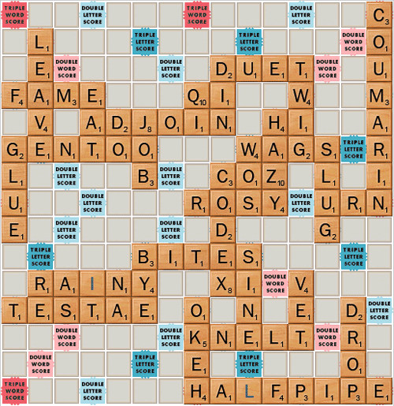
What is MathGames and how can this project provide support in the learning process?

Slide 4
To what extent do puzzles and games influence human development, in general, and mathematics learning, in particular?

Slide 5
ΜΗ ΜΟΥ ΤΟΥΣ ΚΥΚΛΟΥΣ ΤΑΡΑΤΤΕ

Slide 6
The Archimedes’ OSTOMACHION puzzle-game

Slide 7
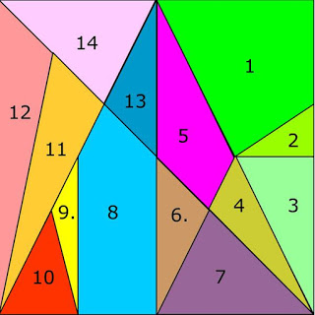
Given a square which has been divided in 14 other figures as can be seen in the following figure, it is required
To construct other squares by rearranging all the given pieces-figures
To find the number of all such squares that can be constructed

Slide 8
The pieces into which the square is divided follow the geometrical constructions suggested by the following figure:

Slide 9
In 2003, mathematicians, using combinatorial approaches and digital means, determined that the number of such squares is 17,152. So it took more than 2000 years to find a solution

Slide 10
The MathGames Methodology

Slide 11
In describing the MathGames Methodology the following elements are proposed as a guiding framework
The context of the project
The determinants that provide the educational forum for exploiting games in the process of learning mathematics
The indulging on the intellectual products of the project that can be used as tools for achieving the goals of the project
The process of designing approaches or lessons for exploiting the outputs of the project
The consideration of Managing and evaluating the learning activities

Slide 12
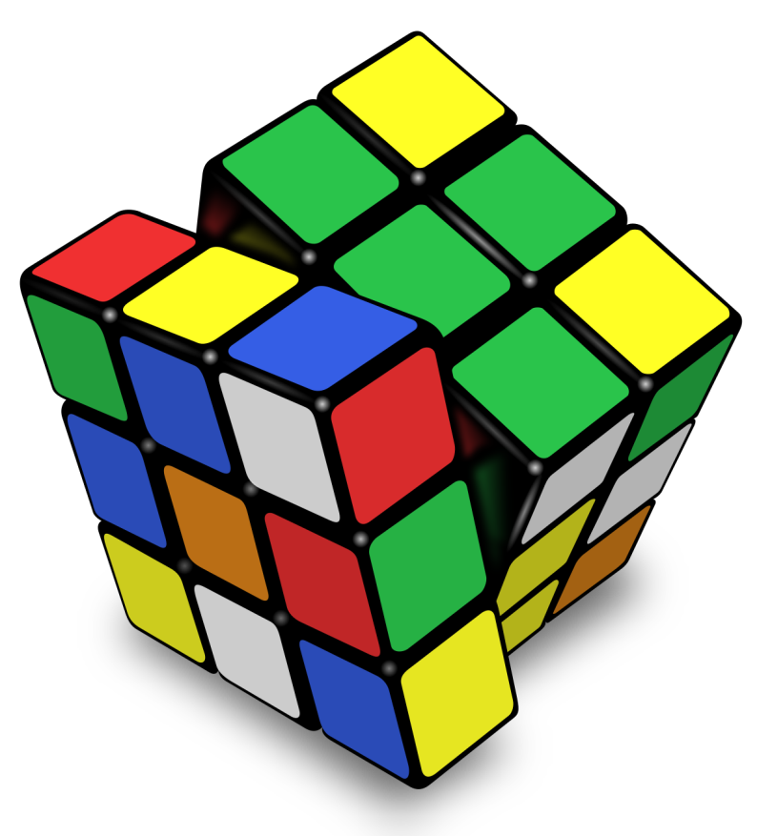
What are the elements/ concepts that lie behind the Project and how do these form the context for a leaning methodology ?

Slide 13
Element 1 :The context of the project
Mathematics
Games
The Guiding questions of the Project.
How can we reduce the number of under skilled adults to promote social integration and participation into our society?
How can we increase incentives for adult training by using games?
How can we offer tailored learning opportunities to individual learners by using games?
How can we provide information on accessing to the services of adult learning?
How can we save traditional and famous games in different countries from being lost?
Notes:
Consequently all

Slide 14
The significance of this context stems out of the central role that both mathematics, as well as games play in our life, not only now, with the extensive progress in science and technology but all the way from ancient time to today. Just to stress this I would like to just to mention what Aeschylus, quotes in the “Prometheus Bound”. He points out that besides the fire, which Prometheus gave to people, “And yes, I invented for them numbers, too, the most important science”. As for the games the starting point of this presentation is very indicative

Slide 15
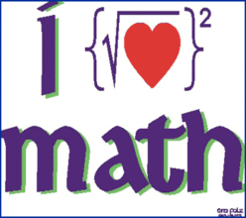
The next issue refers to the factors that set the educational forum of principals that guide the use of the games in the learning process.

Slide 16
Element 2: The determinants that provide the educational forum for exploiting games in the process of learning mathematics
Among these one should stress:
The Goals of mathematics
The Role of Games in Learning, in general, and Mathematics in particular
A set of cognitive and affective Factors that are influencing the process of learning mathematics

Slide 17
The main goals of mathematics education, are to prepare students to:
Solve problems
Communicate and reason
Make connections between mathematics and its applications
Become mathematically literate
Appreciate and value mathematics
Make informed decisions as contributors to society.

Slide 18
Expected Benefits from games in the process of learning mathematics
Creating Interest and Promoting Motivation
Utilizing the Benefits That Games Provide in Engaging Learners in an Environment of Experiential and Active Learning
Socializing the Persons Involved and Exploiting the Competition and Challenge Element
Connecting to Real Life Situations.
Developing a Happy and Joyful Environment.
Utilizing the Design (Structure, Rules, Equipment, Problem Posing etc.) of a Game in Order to Develop an Appropriate Learning Approach

Slide 19
Cognitive and affective Factors that are influencing the process of learning mathematics
Such factors include
Language Issues
Cognitive Factors
Metacognitive Factors
Motor Factors.
Social and Emotional Factors
Habits of Learning
Previous Experiences.

Slide 20
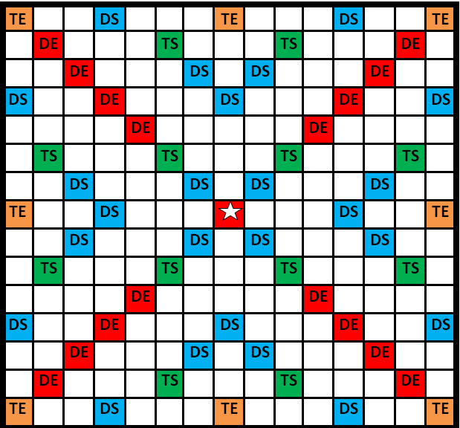
The next issue concerns with the need for the teacher and the learner to the resources that the project produced in order to realise the expectations of the project

Slide 21
Element 3: The indulging on the products of the project that can be used as tools for achieving the goals of the project.
These are the means developed by the project that can help in facing the issues that the project is addressing?
The Compendium
The Guidebook
Material that can be used for construction or comprehension of the games
A Training Course providing guiding principles to the trainers for using the ideas of the project.

Slide 22
All these can be a accessed, using the webpage of the project: http://www.math-games.eu

Slide 23
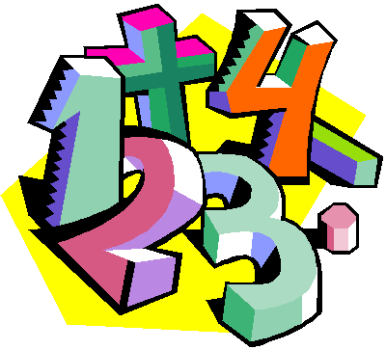
Okay we have resources but HOW DO WE DESIGN A LESSON using a game,

Slide 24
Element 4: The process of designing approaches or lessons for exploiting the outputs of the project
This process covers:
Deciding on the mathematical content to be covered or supported through the game
Identifying suitable games
Decision on the Approaches- identification of games that can help in this process
Setting objectives
Devising lessons and exploiting existing worksheets for the teacher and the student
Devising lessons that exploit various advantages that the use of games offer in the learning process (eg. Are they supporting the general goals of mathematics)
Some of the games are difficult. Developing lessons with gradual difficulty

Slide 25
One of the important decisions in this process concerns the adoption of the approach we feel will be the most fruitful in using a game
An Introduction to a Mathematical Topic?
An opportunity for Creating a Happy and Joyful Environment?
An Actual Educational Medium for Comprehension of Mathematical Concepts and Processes?
An opportunity for Consolidation of Otherwise Learned Concepts or Processes?
An opportunity for Relating Mathematics to Real Life Situations?
An opportunity for Developing Problem Solving and Critical Thinking Skills?
An opportunity for Boosting Creativity, Productivity and Innovation?
An opportunity for Fixing Relationships’ Difficulties among the Learners?

Slide 26
Last but not least How do we keep track of management and assessment issues in the learning process?

Slide 27
Element 5: The consideration of Managing and evaluating the learning activities
Classroom management
Support and Guide to the learner for designing and constructing or finding games
Reflection by the learner and the teacher on the extent of effectiveness of the methodology for learning mathematics
Reflection by the learner and the teacher on the extent of effectiveness of using a particular game for learning mathematics
Review, simplify, adapt or extent the game according to what we observe in using it

Slide 28
Thank you
Have a nice time

